Slide 1
Capstone Engagement
Assessment, Analysis, and Hardening of a Vulnerable System

Slide 2
Table of Contents
This document contains the following sections:
01
Network Topology
02
Red Team: Security Assessment
03
Blue Team: Log Analysis and Attack Characterization
Hardening: Proposed Alarms and Mitigation Strategies
04

Slide 3
Network Topology
‹#›

Slide 4
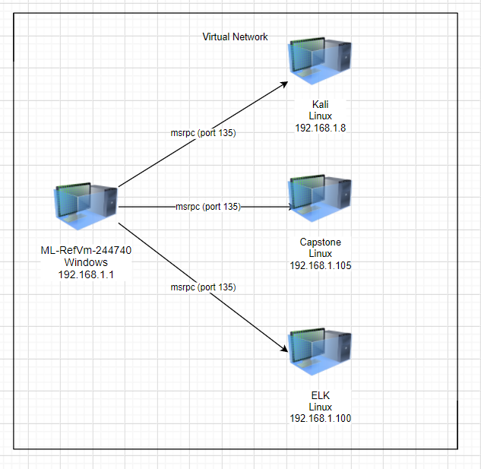
Network Topology
Network
Address Range: 192.168.1.0-255
Netmask: 255.255.255.0
Gateway: 10.0.0.1
Machines
IPv4: 192.168.1.1
OS: Microsoft Windows
Hostname: ML-RefVm-244740
IPv4: 192.168.1.8
OS: Linux
Hostname: kali
IPv4: 192.168.1.105
OS: Linux
Hostname: Capstone
IPv4: 192.168.1.100
OS: Linux
Hostname:
ELK

Slide 5

Red Team
Security Assessment
‹#›

Slide 6
Recon: Describing the Target
Nmap identified the following hosts on the network:
Hostname | IP Address | Role on Network
ML-RefVm-244740 | 192.168.1.1 | Host Machine
Capstone | 192.168.1.105 | Target Machine/Web Server
Kali | 192.168.1.8 | Attack Machine
ELK | 192.168.1.100 | Log analysis

Slide 7
Vulnerability Assessment
The assessment uncovered the following critical vulnerabilities in the target:
Vulnerability | Description | Impact
WebDAV Enabled | Public access to the file system through the web server | Allows someone to navigate the file system in the URL
Port Scanning Enabled | Allows scanning of ports on a network | A hacker can see the open ports and target a specific attack on one of them
Nothing to Prevent Brute Force Attacks | Nothing in place to prevent trying every possible username:password combination | Using Hydra or John the Ripper has a high chance of success breaking a password

Slide 8
Exploitation: [WebDAV]
01
02
03
Tools & Processes
Code Injection
Achievements
I was able to access confidential and private files
192.168.1.105/company_folders/secret_folder

Slide 9
Exploitation: [Port Scanning]
01
02
03
Tools & Processes
Nmap
Achievements
I was able to see which ports were open and which applications they were using
Nmap 192.168.1.8/24

Slide 10
Exploitation: [Brute Force Attack]
01
02
03
Tools & Processes
Hydra
Achievements
I was able to retrieve a correct password
hydra -l ashton -P /usr/share/wordlists/rockyou.txt -s 80 -f -vV 192.168.1.105 http-get /company_folders/secret_folder

Slide 11

Blue Team
Log Analysis and Attack Characterization
‹#›

Slide 12

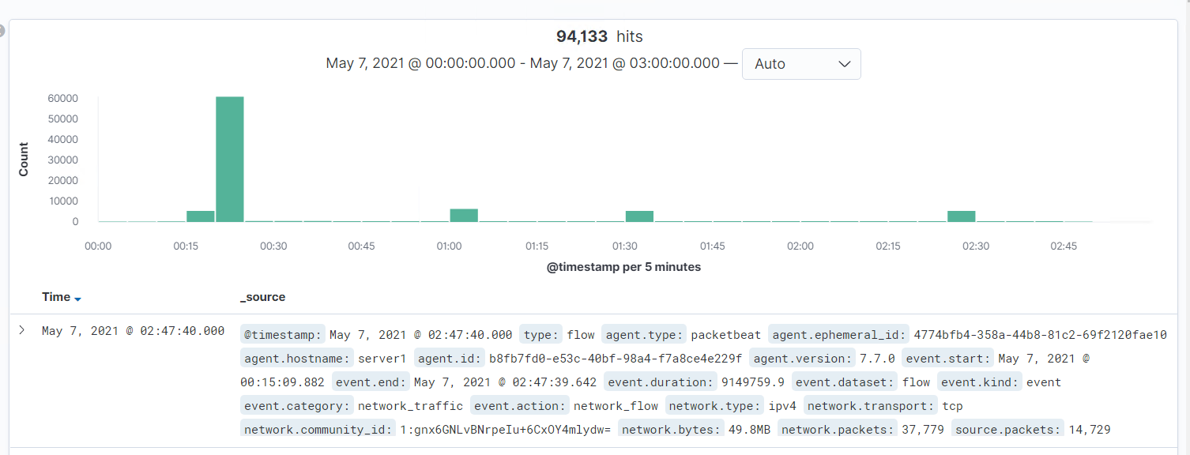
Analysis: Identifying the Port Scan
Answer the following questions in bullet points under the screenshot if space allows. Otherwise, add the answers to speaker notes.
What time did the port scan occur? 02:47:00
How many packets were sent, and from which IP? 61059, 192.168.1.105
What indicates that this was a port scan? Instant and large increase in tcp traffic
[Insert Here]
Include a screenshot of Kibana logs depicting the port scan.

Slide 13
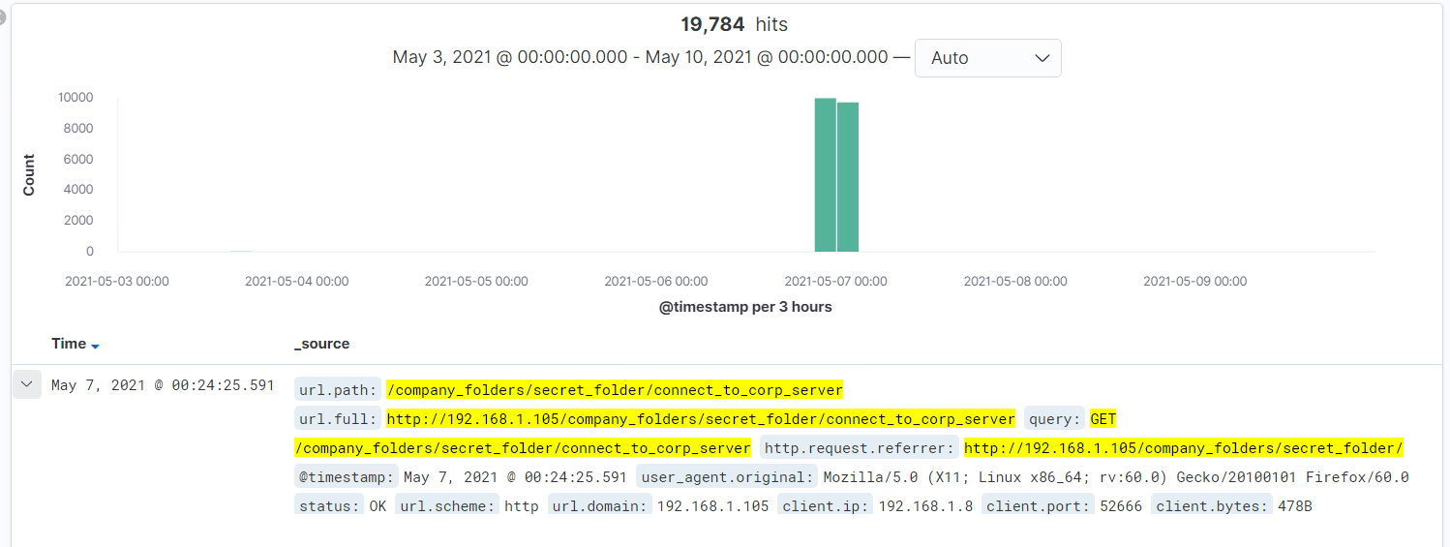
Analysis: Finding the Request for the Hidden Directory
Answer the following questions in bullet points under the screenshot if space allows. Otherwise, add the answers to speaker notes.
What time did the request occur? How many requests were made? 00:24:25.591
Which files were requested? /comany_folders/secret_folder What did they contain? Login username, hashed password, and WebDav instructions

Slide 14
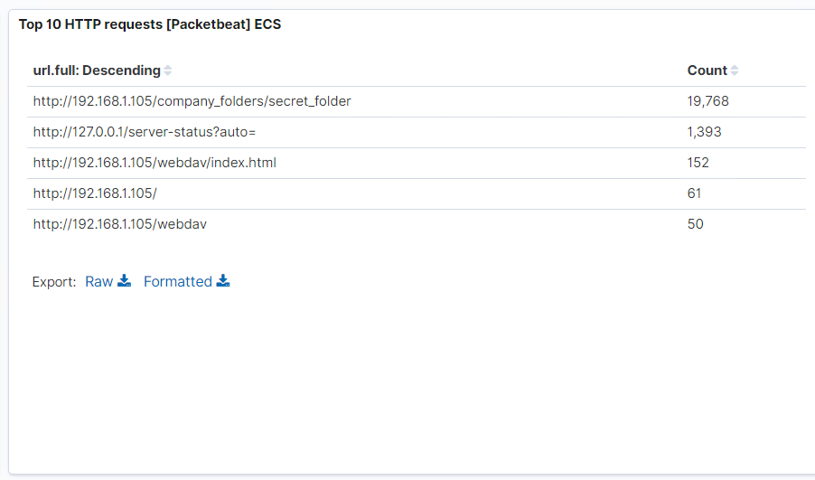
Analysis: Uncovering the Brute Force Attack
Answer the following questions in bullet points under the screenshot if space allows. Otherwise, add the answers to speaker notes.
How many requests were made in the attack? 19, 768
How many requests had been made before the attacker discovered the password? 19, 768

Slide 15
Analysis: Finding the WebDAV Connection
Answer the following questions in bullet points under the screenshot if space allows. Otherwise, add the answers to speaker notes.
How many requests were made to this directory? 202
Which files were requested? http://192.168.1.105/webdav/index.html

Slide 16
Blue Team
Proposed Alarms and Mitigation Strategies
‹#›

Slide 17
Mitigation: Blocking the Port Scan
What kind of alarm can be set to detect future port scans?
An alert when the TCP traffic reaches a certain level
What threshold would you set to activate this alarm?
15 GB per week
What configurations can be set on the host to mitigate port scans?
Use a firewall to limit TCP traffic
Describe the solution. If possible, provide required command lines.
When the traffic reaches the threshold, completely block the port

Slide 18
Mitigation: Finding the Request for the Hidden Directory
What kind of alarm can be set to detect future unauthorized access?
An alert when the number of 401 error codes reaches the threshold set
What threshold would you set to activate this alarm?
50
What configuration can be set on the host to block unwanted access?
A firewall to block the IP address that reaches the threshold of 401 errors
Describe the solution. If possible, provide required command lines.
When an IP reaches the threshold, it no longer has access to the network

Slide 19
Mitigation: Preventing Brute Force Attacks
What kind of alarm can be set to detect future brute force attacks?
An alert when the number of 401 errors goes above the threshold previously set
What threshold would you set to activate this alarm?
50 401 errors within an hour
What configuration can be set on the host to block brute force attacks?
Multi-factor authentication and setting a rule to lock out an account after more than 5 incorrect logins
Describe the solution. If possible, provide the required command line(s).
Requiring a username:password AND security question. Using Snort to configure a rule.

Slide 20
Mitigation: Detecting the WebDAV Connection
What kind of alarm can be set to detect future access to this directory?
An alert sent if WebDAV is ever enabled
What threshold would you set to activate this alarm?
1
What configuration can be set on the host to control access?
Use input validation
Describe the solution. If possible, provide the required command line(s).
Ensures that only properly formed data will be able to travel through the network

Slide 21
Mitigation: Identifying Reverse Shell Uploads
What kind of alarm can be set to detect future file uploads?
An alert send for when any malicious extension is uploaded
What threshold would you set to activate this alarm?
1
What configuration can be set on the host to block file uploads?
File upload verification
Describe the solution. If possible, provide the required command line.
Verifies a file’s extension is legitimate

